Slide 1


Barbara Jinks,
International Gas Union
A NEW ERA OF EFFICIENCY PROGRESS
Natural Gas Delivering on the Challenge

Slide 2


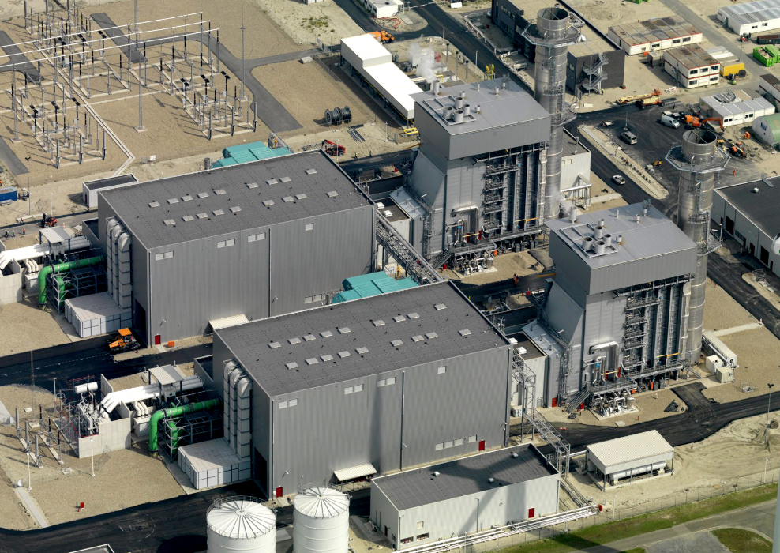
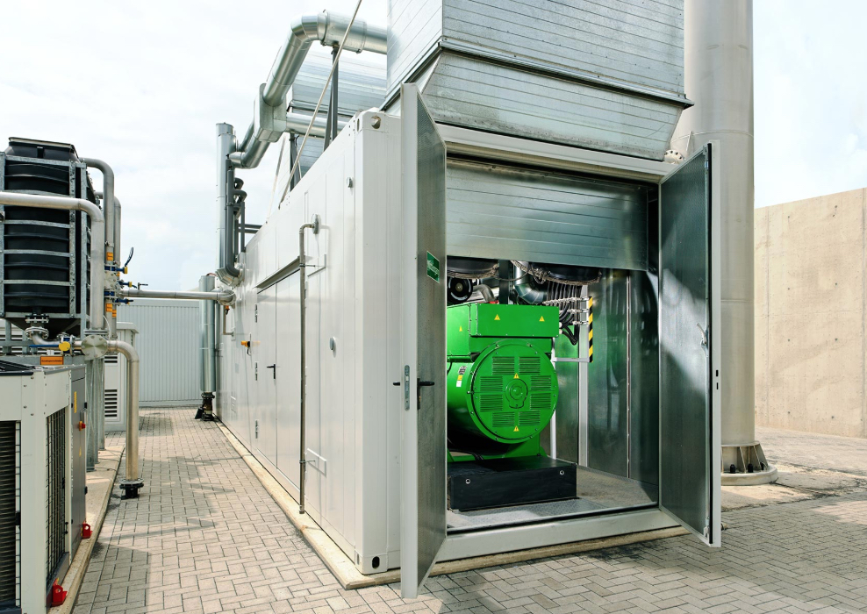
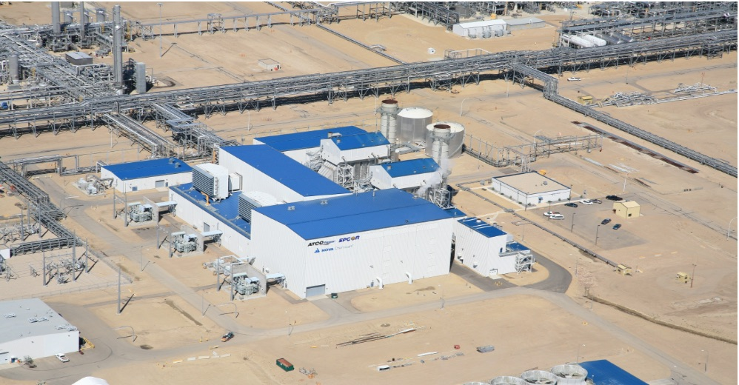
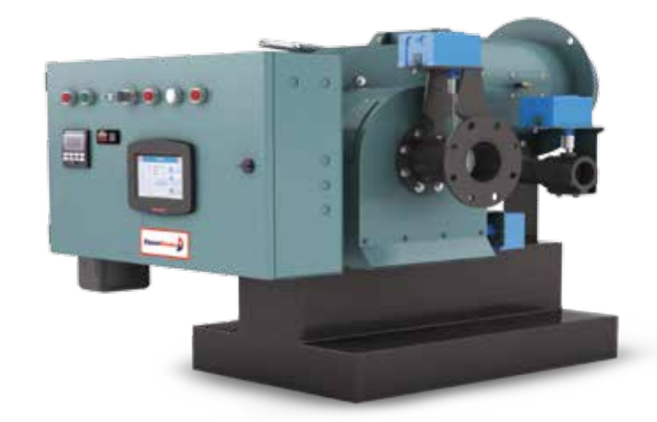
Current Natural Gas End-use Applications Deliver Very High Efficiencies
Domestic and
Commercial Heating
90%+ High
Efficiency Furnaces
90%+ Efficient
Condensing Boilers
Up to 60% Efficiency
Combined Cycle
Power Plants
80% Efficiency
Combined Heat/
Power Plants
Power Generation
Up to 85% Efficiency
Of Cogeneration
Plants
High Efficiency
Industrial Natural
Gas Burners
Industrial Applications

Slide 3
Current Natural Gas Delivery Systems Achieve High System Efficiency
US system

Slide 4

Thank you

